Slide 1
Procurement Review FY 2017-2018 vip July 2017
All Process for Procurement

Slide 2
Purchasing Regulations
All Items will have to be requested and approved in MUNIS with an APPROPRIATE Purchase Order.
Purchase Orders and Student Activity are completed on an hourly basis, but ALL the approvals has to be completed for this to be finalized.
All Vendors will have to be registered and approved prior to doing business within the district.
We will not allow any approvals of vendors if they fall within the “Immediate Family” member category according to the policy
Definition of Immediate Family Member - “immediate family” means a spouse, child, sibling, or parent or the spouse of a child, sibling, or parent.
Please note: While this definition does not include nephews, cousins, nieces, aunts, and uncles, we should make sure all relationships involving these family members are disclosed, and employees should not attempt to influence the decision making process.

Slide 3
Purchasing Regulations
Policy Pertaining to Quotes and Expenditure
All Request Between $1.00 - $9,999.99 (ONE WRITTEN QUOTE).
Call the VENDOR the quote HAS to be WRITTEN and Attached in MUNIS
All Request Between $10,000.00 - $28,000.00 (Three Written Quotes, attached in MUNIS).
All QUOTES has to be ATTACHED IN MUNIS
All Request over $28,000.00 (Discussion with Elaine Wilson, pertaining to Seal Bid).
Complete INTERNAL Request (Action Memo) requesting seal bid, indicating all pertinent information such as funding source, approval, start and end dates.
All Request over $100,000.00 (Board Approval, Mandated).

Slide 4
MUNIS FY 2017 – 2018 (Purchasing)
MUNIS
Login (Secured and Confidential)
Please do not SHARE credentials
Approvals (completed by the responsible party)
When you are out of the office, you have the ability to FORWARD your approvals to an designated party. Please see instructions on the next slide. We strongly ENCOURGE this to take place.
All request for items for payment has to be presented in MUNIS either via (Requisition Module, or Student Activity Module).
Receiving Items – All Items will have to be received in the system by the Bookkeeper/Media Specialist/Secretary within 48 hours of DELIVERY).
All Approvals will have to be completed within 48 hours of releasing into the system (First Level).
We can implement on your Smart Phone
We can implement on your “Laptop or Surface Pro” if needed.

Slide 5
Munis Do’s and Don’t
Munis Quote:
All Request HAS to have a QUOTE attached.
NO CATALOG (Page Copies), but an ACUTAL QUOTE (Call VENDOR) and Receive a VITAL QUOTE
Ensure No Sales Tax
Products are Updated with Correct Pricing
Correct Ship To Information
Ensure that you have an expiration date for all product.
Remember to “DO BLANKET” requisitions by AMOUNT
Remember to do PICK TICKETS for ALL INTERNAL warehouse request.
RELEASE the Requisition for PROCESSING

Slide 6
E-procurement Vendors
NO QUOTE NEEDED For E-PROCUREMENT VENDORS
Staples
Office Depot
CDW
Kaplan
School Specialty
Amazon (Special Circumstances)
Complete as a SHOP ONLINE (MUNIS RIBBON) to make sure the order flows correctly. CALL YOUR PROCUREMENT REPRESENTATIVE if you have any questions.

Slide 7
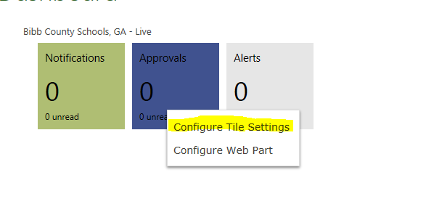
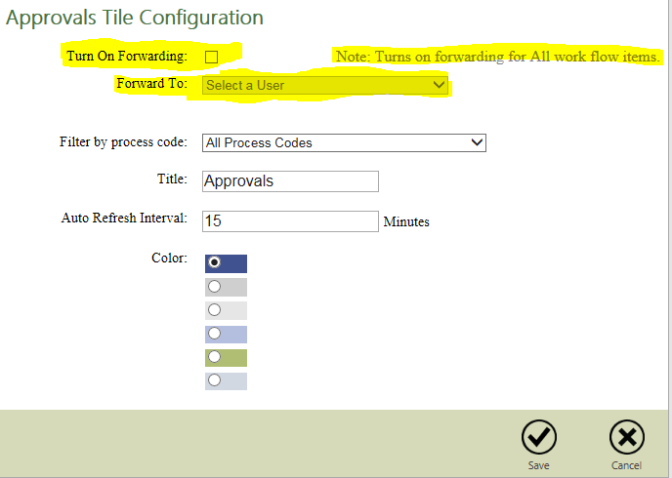
How To Approve
On the Munis Dashboard, RIGHT click on the APPROVAL tile and select “Configure Tile Settings”.
Then you will see the following information. They will need to click on the box and it will give them access to select someone to forward all of their work flow items. When they return, they will need to unclick the box.

Slide 8
Purchase Order Inquiry
Tyler Menu
Financial
Purchasing
Purchase Order Inquiry and Reports
Purchase Order Inquiry
Search
Implement PO Number
Accept
All information pertaining to the PO can be retrieved

Slide 9
Vendor information
Vendor Registration ONLINE only
www.bcsdk12.net – Departments – Procurement – Vendor Registration (Under Vendor Registry)
Immediate Family Relationships
NO Double Dipping (Employee and Consulting)
Updated Information
W-9 Attached
TRS Retirees
Approval Required By HR (PRIOR) to utilizing the services.

Slide 10
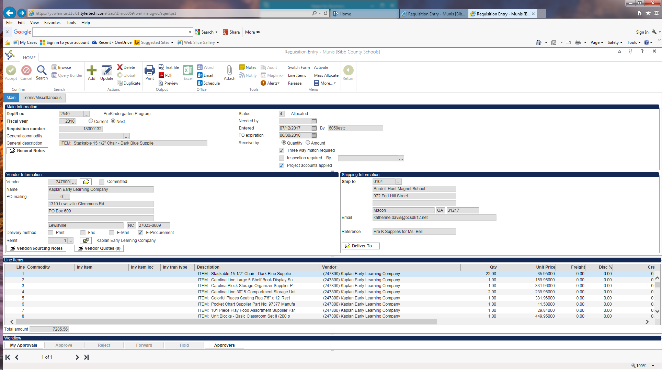
Vendor Issues on E-Procurement Orders
Ensure you Choose the CORRECT Vendor NUMBER on Page 1 and the Line Items for the E-procurement Vendors

Slide 11
Requisition Monthly deadline
Month | Last Day to KEY
July 2017 | July 27th
August 2017 | August 29th, 2017
September 2017 | Wednesday Sept 27th, 2017
October 2017 | Friday October 27th, 2017
November 2017 | November 28th, 2017
December 2017 | December 20th, 2017
January 2018 | January 29th, 2018
February 2018 | February 26th, 2018
March 2018 | March 28th, 2018

Slide 12
END of Month Deadline
Month | Last Day To KEY
Keep In Mind - - We will have an END OF YEAR SPEND DATE FOR GENERAL FUNDS; in Feb or March
Federal FUNDS
April 2018 | April 26th, 2018
May 2018 | May 29th, 2018
June 2018 | June 27th, 2018

Slide 13
Training
Procurement Offers Additional Training
Monthly (2nd Thursday of Each Month)
1:00 – 3:00 PM
Sign Up with your Procurement Buyer

Slide 14
Warehouse Processing
Track It
All request for furniture, moving items, asset relocation will have to be completed in Track It. This is the only way to guarantee proper scheduling.
Pony Process:
Inter Department Envelopes:
Reliable Organization: Please remember to make sure all mail is sent in the Interdepartmental envelopes.(Reliable Organization).
All Packages Delivered via Pony Mail will be signed for as if we are using an outside agency (Accountability).

Slide 15
Warehouse contact person
Warehouse Delivery Zone Assignments
Charlie
Alexander ll
Appling
Burdell
Bernd
Central
Hartley
Miller
ML King
Northeast
Riley
RJ Williams
Williams
Vineville
Warehouse Delivery Zone Assignments
Horace
Brookdale
Carter
Heritage
Howard MS
Howard HS
Lane
Northwood
Springdale
Soar Academy
Taylor
Union
Weaver
Westside
Warehouse Delivery Zone Assignments
Dwight
Ballard
Bruce
Campus Police
Elam Alexander
Heard
Ingram-Pye
Porter
Rutland MS
Rutland HS
Skyview
Southfield
Southwest
Veterans

Slide 16
Copier Contract Information
Contracts:
Contracts are being completed, and has to be signed so the procurement department can key the requisitions to ensure ALL maintenance are implemented on the machines for FY 2017-2018
Individual Budgets Responsible for Maintenance Agreement including Riso. Machines.
All Printing Services has to be completed in Wish Printing, prior to seeking outside resources.
If wish is unable to provide the services they will notify you in writing (Wishprinting@bcsdk12.net).
NEW SERVICES FOR FY 2017 – 2018 (Envelopes)

Slide 17
Procurement Contact Person
Zone Information
Stephanie
Alexander ll ES
Bernd ES
Brookdale ES
Bruce ES
Burdell-Hunt ES
Campus Police
Capitol Improvement
Carter ES
Central HS
Fine Arts
Hartley ES
Howard MS
Howard HS
Hutchings Promise Ctr.
Ingram Pye ES
Kindergarten
Lane ES
Miller MS
PEC Department
PEP Grant
Professional Development
Risk Management Rutland Middle and High School Soutfield Elementary School
Zone Information
Debra
Afterschool
Appling MS
Athletics
Ballard- Hudson MS
Communications
Elam/Elam Alexander
Gear Up
Heard ES
Heritage ES
L H Williams ES
MLK ES
Northeast HS
Northwoods Academy
PBIS - Curlanda Smith
Porter ES
Psycho Svcs
Skyview ES
Soar Academy
Southwest HS
Springdale ES
Student Support
Taylor ES
Union ES
Veterans ES
Vineville ES
Weaver MS
Westside HS
Zone Information
Lavette
Administrative Offices
Assessment and Accountability
CTAE -Promise Center
Human Resources
Legal
Maintenance Dept.
Procurement /Warehouse
School Nurtrition
Technology
Title 1
Transportation

Slide 18
Case of paper per teacher
The Warehouse Staff will begin to distribute ONE case of paper to each location (Per FULL time Teacher).
Week of August 7 – 11th, 2017
Delivery Ticket will be prepared and has to be signed OFF for receiving documentation.

